Slide 1

Modeling II

Slide 2
Introduction
Instructions
Download Tutorial Zip
Unzip Folder
Required Packages
Open .Rmd File and Knit
Daily Spanish River Data
W = Max Water Temperature
A = Max Air Temperature
L = River Identifier (31 Rivers)
library(tidyverse)
library(modelr)

Slide 3
Introduction
Questions About RMarkdown
What Does the Following Code Do When Knitted?
What Does the following Code Chunk Option Do When Knitted?
`r length(unique(DATA$L))`
echo=F

Slide 4
Introduction
Goal: Build a Model to Predict Max Water Temp Given Max Air Temp
What Do You Know About the Relationship of These Variables?
Who Would Care About this Relationship?
Why Would Someone Want to Predict the Max Water Temp?
Why Would this Model Be Useful?

Slide 5
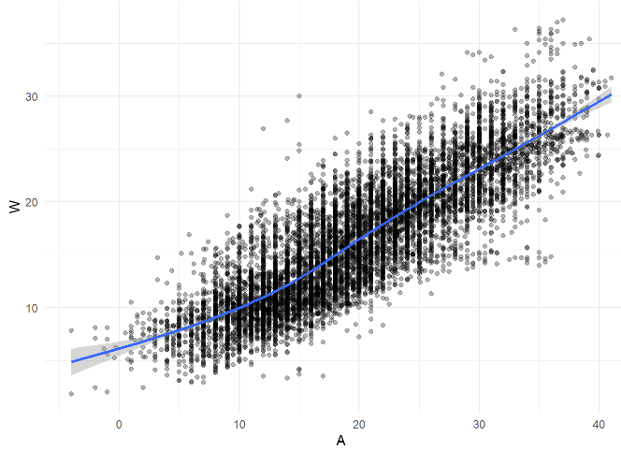
Part 1: Examining the Relationship
Run Chunk 1
What Do You Notice About the Overall Relationship?
Do You Think This Relationship is the Same for All Locations?
Why?
message=F

Slide 6
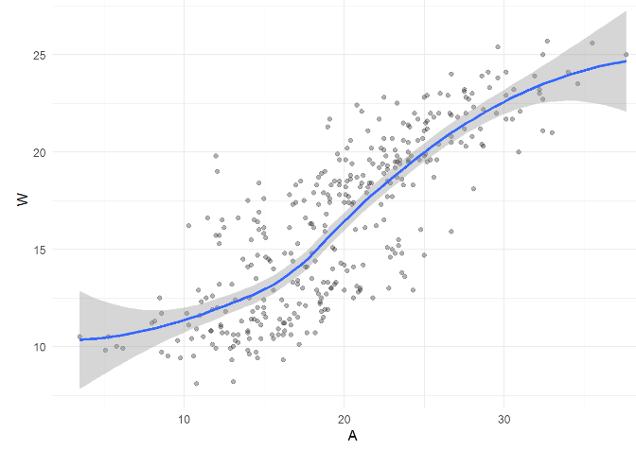
Part 1: Examining the Relationship
Run Chunk 2
Location is a Numeric Variable
What Do You Notice About the Relationship for L==103?
What do You Notice Now?

Slide 7
Part 1: Examining the Relationship
Chunk 2 Modified
Modify Chunk 2 to Create a Function Called WAPlot.func With 1 Argument Location
Function Usage: You Specify the Location as an Integer and the Function Outputs a Figure of the Relationship
Use Your Function For Three Different Locations
Knit the Document to Observe and Compare

Slide 8
Part 1: Examining the Relationship
Chunk 2 Discussion
What are the Differences in the Relationship Between W and A for the Various Locations?
Why do You Think These Differences Exist?
How do You Suggest We Handle the Differences?

Slide 9
Part 1: Examining the Relationship
Chunk 3
Randomly Samples 3 Locations
Plant Your Seed and Run Code
Usage:
anti_join()
semi_join()
Why Don’t We Handpick the Three Locations?

Slide 10
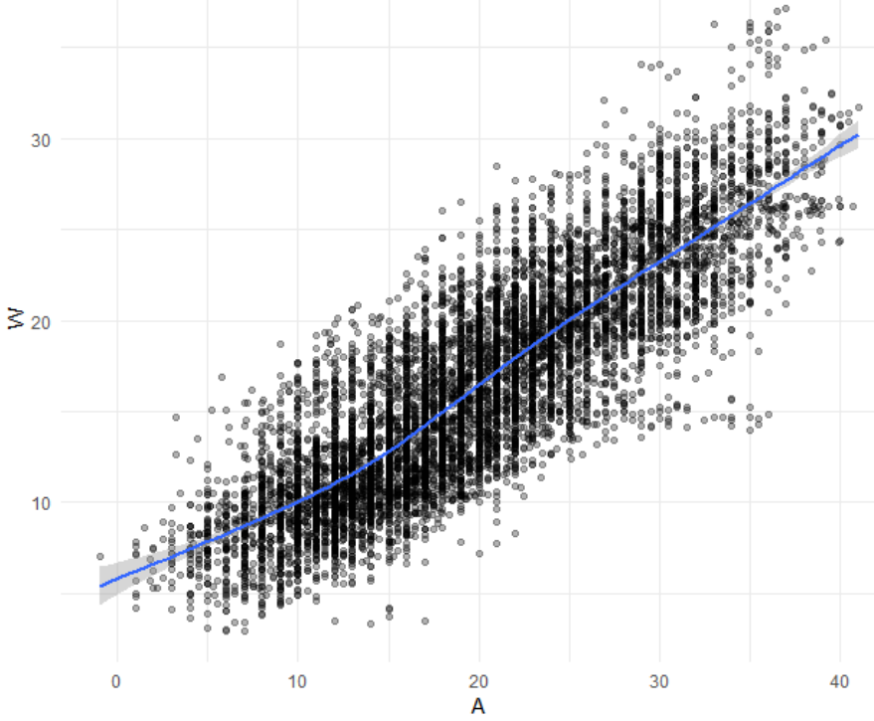
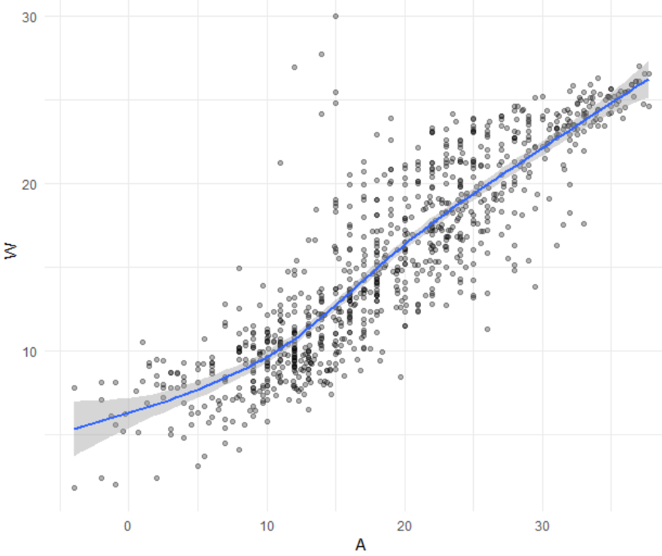
Part 1: Examining the Relationship
Run Chunk 4
Train Plot
Test Plot

Slide 11
Part 2: Linear Model
Linear Model
Simplest Relationship that is Easily Explained
For every 1 Degree Change in A, W changes by b Degrees
When A=0 Degrees, the Expected Water Temperature is a Degrees
$$W=a+bA+ ε$$

Slide 12
Part 2: Linear Model
Run Chunk 1
Fits Linear Model to Train Data
What is Your Intercept?
What is Your Slope?
Run Chunk 2
Saves Predictions to Train/Test
Run Chunk 3
Saves Residuals to Train/Test
add_predictions(MODEL,var=“NAME”)
add_residuals(MODEL,var=“NAME”)

Slide 13
Part 3: Polynomial Model
Polynomial Model
“Feature Engineering”
Generalized Additive Model
Geom_smooth() Fits a GAM when Fitting a Curve
Useful for Approximating Nonlinear Relationships
Dependent on Degree “k”
Goal: Choose Best “k”
$$W=a+b_{1}A+b_{2}A^{2}+…+b_{k}A^{k}+ ε$$

Slide 14
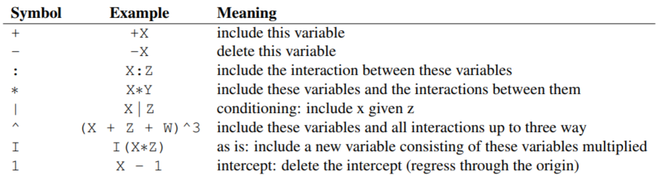
Part 3: Polynomial Model
Formula Object in R
Special Notation
Helpful Table:
We will Use the I() Function to Create New Variables Based Off Variables We Have

Slide 15
Part 3: Polynomial Model
Run Chunk 1
Fits 2nd Degree Polynomial
Fits 3rd Degree Polynomial
Fits 4th Degree Polynomial
Run Chunk 2
Obtains Predictions Under the Different Polynomial Models

Slide 16
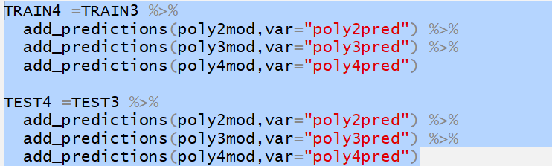

Part 3: Polynomial Model
Chunk 3
Code Needs Modification
Highlight Code
TRAIN3 -> TRAIN4 and etc.
Use Ctrl+F (Find and Replace)
‘predictions’ -> ‘residuals’
‘pred’ -> ‘res’
Run Chunk 3 After Modifying

Slide 17
Closing
Disperse and Make Reasonable Decisions

